Slide 1

Uttaranchal University, Dehradun
BACHELOR OF TECHNOLOGY(CSE) 2022-23
Shopping Portal
SUBMITTED BY:-
Sameer Ahmed, Abhay Pundir, Sandeep Singh Rana, Rahul Kumar

Slide 2
OUTLINES
Introduction
Objectives
Requirements
Website Overview
Program used
Future Scope
Conclusion

Slide 3
Introduction
At Shopping Cart , we've meticulously curated a diverse range of high-quality products, handpicked from trusted suppliers and renowned brands. From trendy fashion apparel to state-of-the-art gadgets, from exquisite home furnishings to must-have beauty essentials, our extensive collection caters to all your desires and preferences.
We also offer multiple shipping options, allowing you to choose the method that suits you best, and our reliable delivery partners ensure your purchases arrive promptly at your doorstep.

Slide 4
Objective
Provide user-friendly platform for customers to browse, select, and purchase products.
Increase sales by reaching a wider audience and offering a variety of products.
Create trust and credibility with customers through secure payment methods, reliable shipping, and customer support.
Stay competitive in the e-commerce market by keeping up with emerging technologies and trends.

Slide 5
Requirement:
Software:
Window OS: xp / 7 /8 /10 /11
Or Mac OS
Or Linux
Browser like(Chrome, Mozilla, Opera)
Hardware:
Processor: Pentium or Higher
RAM: 128 or Higher

Slide 6
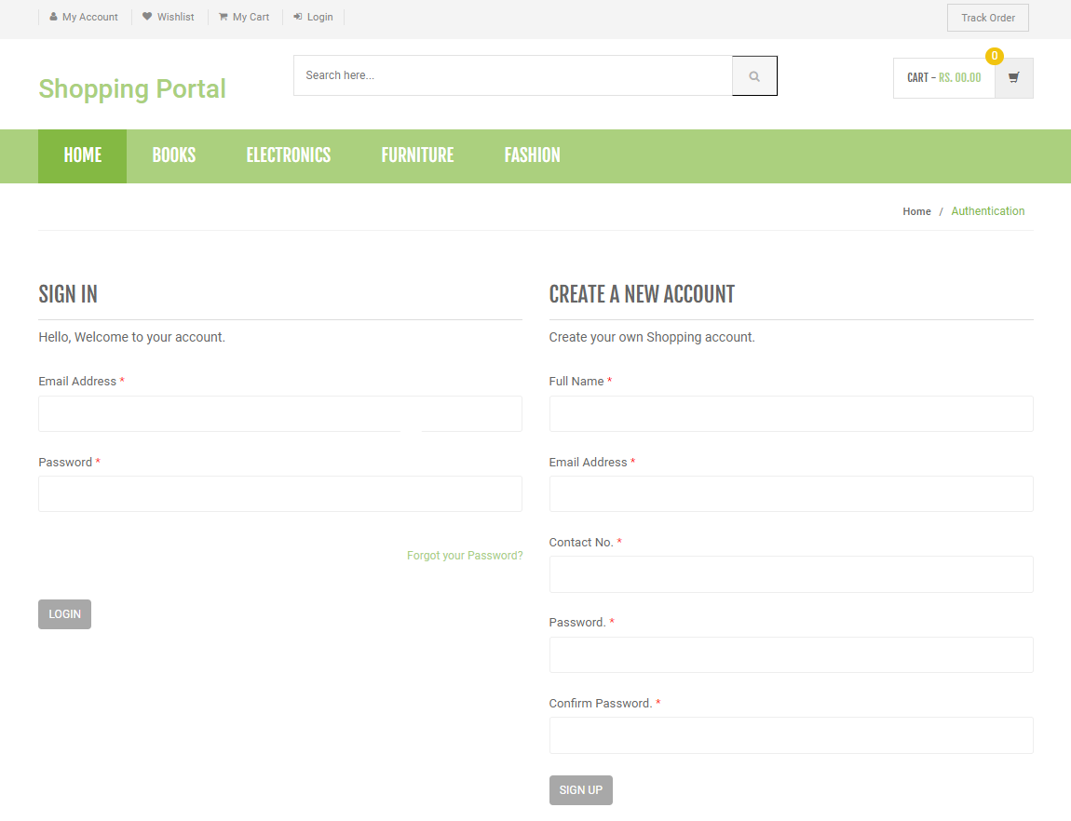
Search Box
Cart
Sign Up
Login

Slide 7
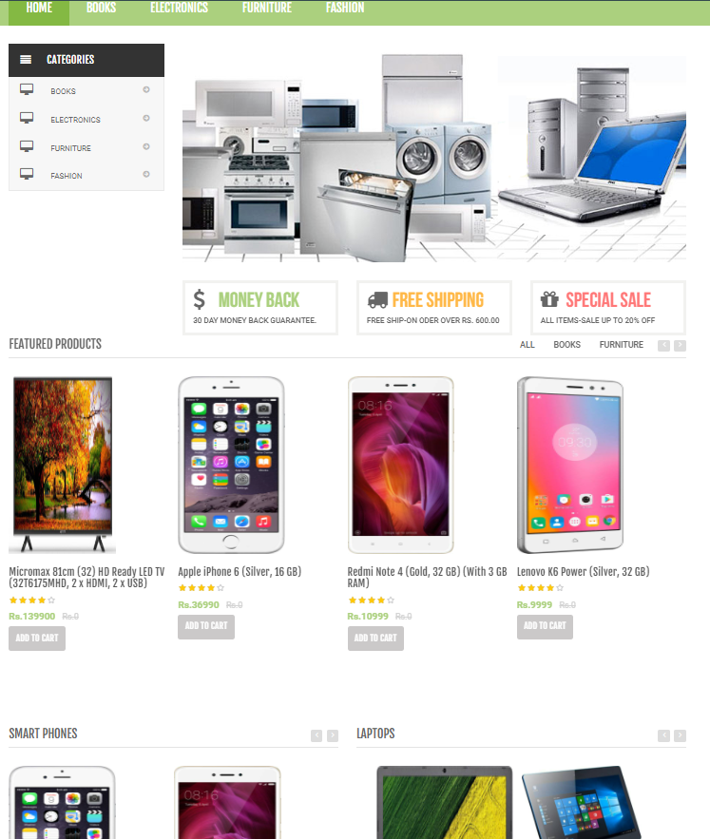
Products

Slide 8
Programming Used
Front-End Development:
HTML
CSS
JavaScript
Bootstrap.
Back-End Development:
PHP
JavaScript
Database:
MySQL

Slide 9
Future Scope
The Project made here is just to ensure that this to ensure that this product could be valid in today real challenging world. Here all the facilities are made and tested.
Currently it is not visible on virtual world (Internet) because of some limitation of project. In future it may be there.

Slide 10
Conclusion
Online shopping websites are essential in modern e-commerce, providing consumers with a convenient platform to browse, select, and buy products.
The design of these websites greatly influences user satisfaction and purchasing behavior.
Key factors such as website quality, visual appeal, usability, navigation, and responsiveness all contribute to creating a positive user experience.
Ultimately, creating a successful shopping website requires an effective design, seamless user experience, trust-building measures, and the integration of emerging technologies.

Slide 11

THANK YOU

